Slide 1
Testing Review – New Baggage Policy
February, 2020

Slide 2

+0.20% on conversion to Passengers (not conclusive) coming from Flight Search Page*
Original
Discount Green Ribbon
+0.20% on conversion to Passengers coming from Flight Search Page
Discount Price Down
Price Icon
-0.21% on conversion to Passengers coming from Flight Search Page
-0.34% on conversion to Passengers coming from Flight Search Page
Hypothesis
Making more visible to the customer that the basic fare has a lower price, will improve the conversion to the next step and conversion overall
Duration: 4 days (February 6th – 10th)
Next Steps
Consider this implementation for the new site
Send the Ribbon variation vs Original

Slide 3
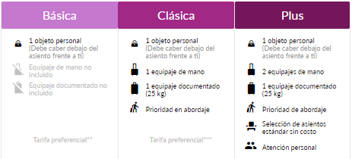
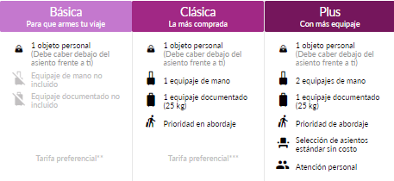
+0.3pp conversion from Flight Search → Passengers with descriptive copies in each of the fares (not conclusive)
Original
Fare Descriptive Copies
Positive Trend conversion from Flight Search → Confirmation
+.3pp conversion from Flight Search → Passengers
Hypothesis
Making more visible to the customer a description of each fare, will help them to choose which option they prefer
Duration: 4 days (February 10th – 13th)
Next Steps
Consider this implementation for the new site

Slide 4
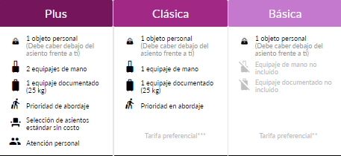
Fare Rearrange running since Feb 13
Original
Rearrange of fares
Hypothesis
If we rearrange the fare´s order, this will increase the classical fare share, therefore, improve conversion rate. This test is based on a Profeco recommendation

Slide 5
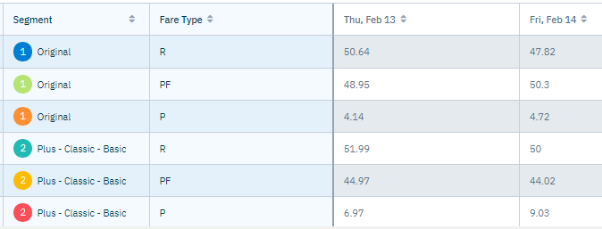
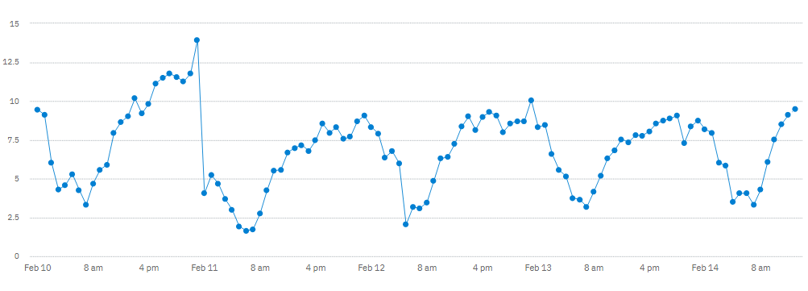
In the first 24hrs of rearrange flights, Fares are changing its share without harming the conversion
Rearrange insights first 24hrs
Plus fare increased up to ~8% its share from all web transactions (+3.6pp increase)
Classic increased up to ~50% of transactions (+1.7pp)
Basic reduced to ~44% (-5.1)
There’s no reduction in conversion to the next step, nor in the funnel conversion

Slide 6
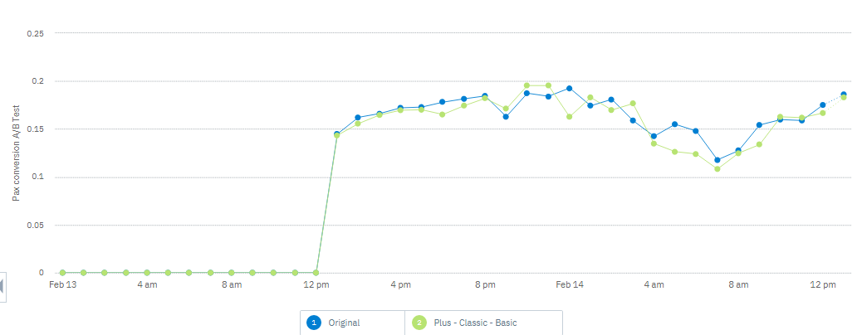
Comparing each of the variations in last 24hrs,the reduction at 8pm on Feb 13 is the same in both variations

